Slide 1
A Machine Learning Approach to Pricing Corporate Bonds
November 12, 2013

Slide 2
Overview
Bonds/Fixed Income are the most important asset class for retiree investment portfolios
With a rapidly aging baby boomer population, making sure fixed income returns is more important than ever
Against the backdrop of rising interest rates, the winding down of accommodative fiscal policy and negative year to date returns many bond managers are struggling
As a result many are turning to scrutinizing their trading costs
Bonds rarely trade – so what do you use as your benchmark?
Several companies provide “evaluated pricing” however it tends to be poor quality

Slide 3
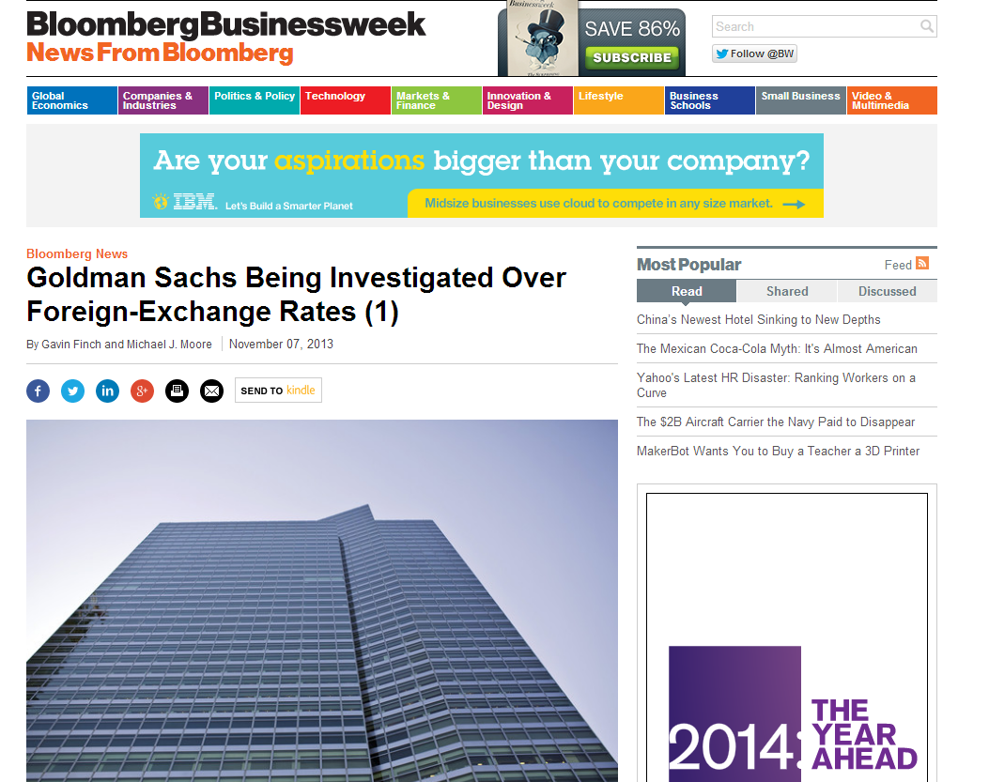
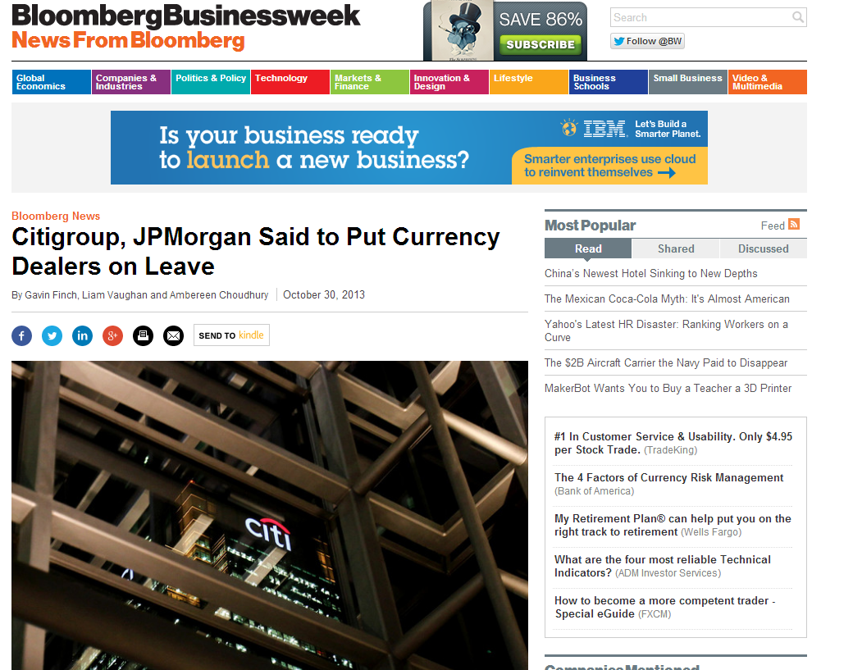
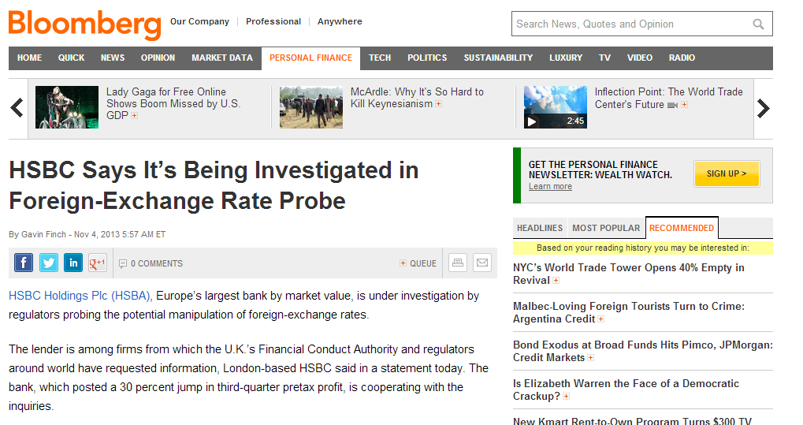
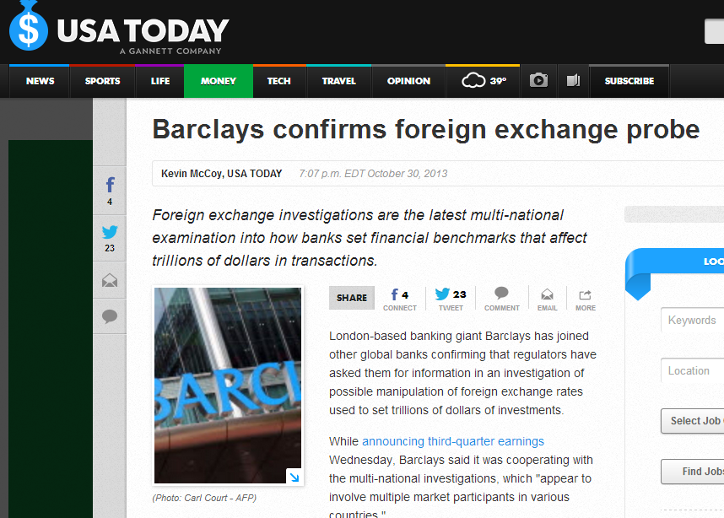
Fraud!

Slide 4
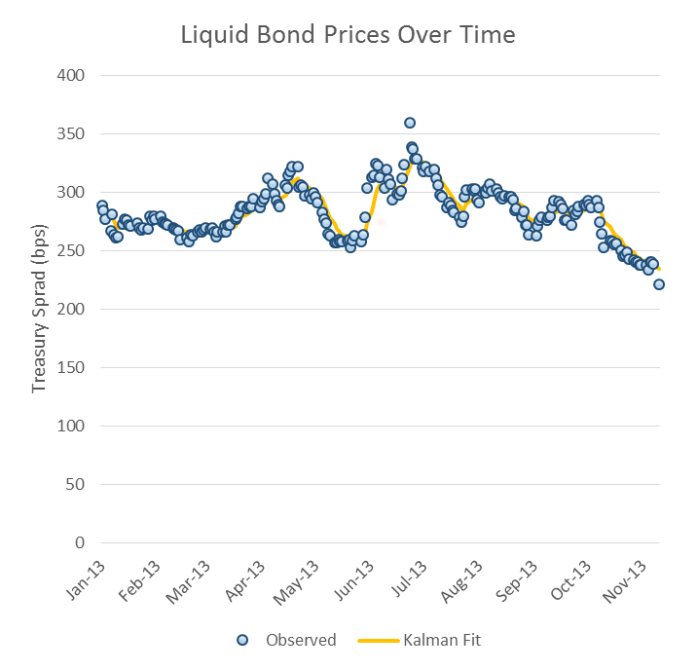
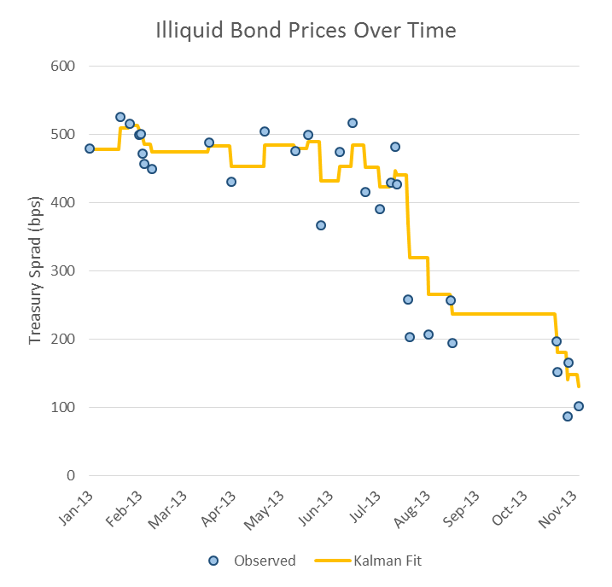
Bond Trading Frequency

Slide 5
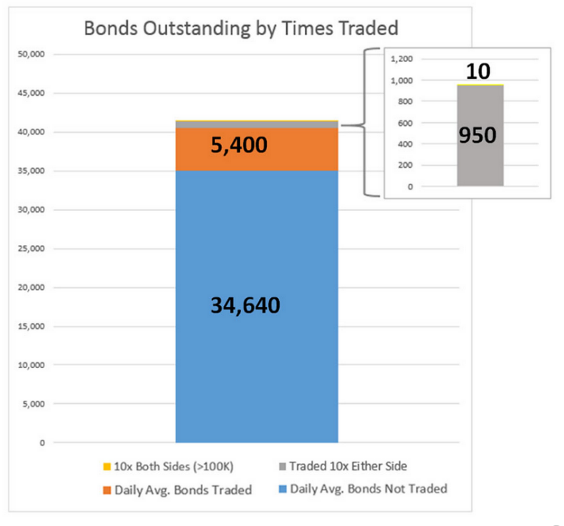
Bond Trading Frequency

Slide 6
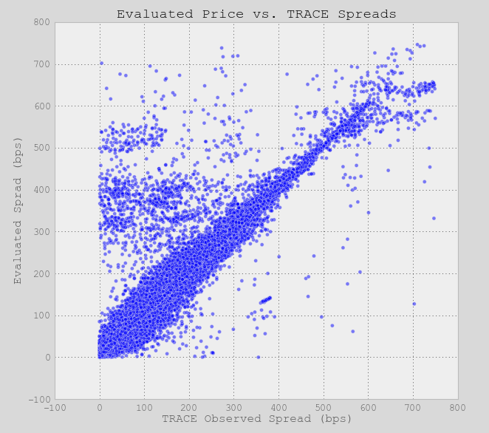
Evaluated Pricing Accuracy

Slide 7
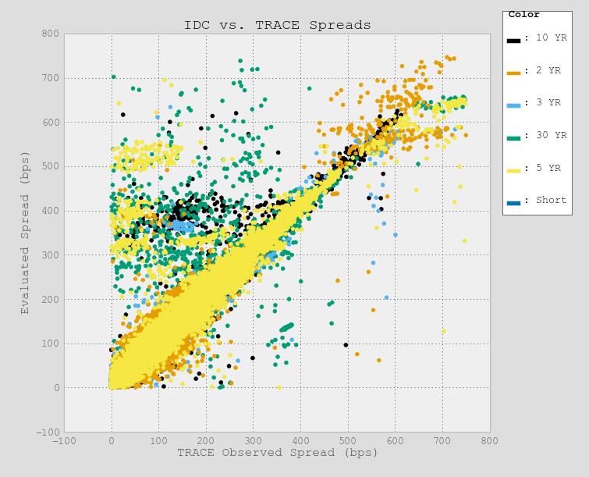
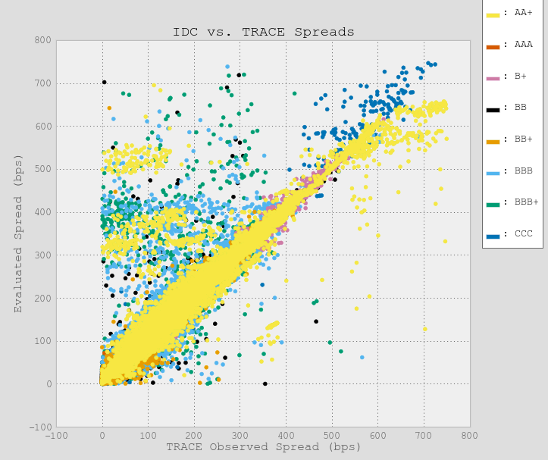
Bond Characteristics

Slide 8
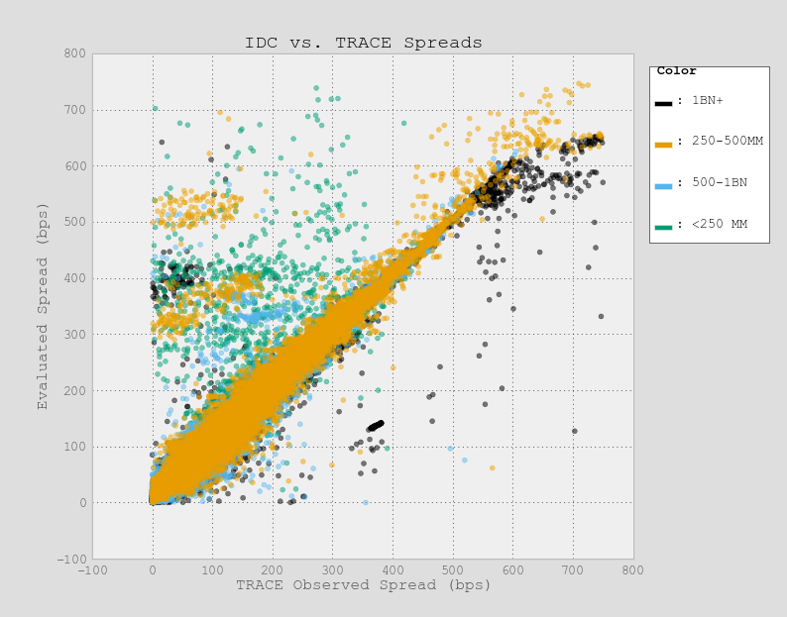
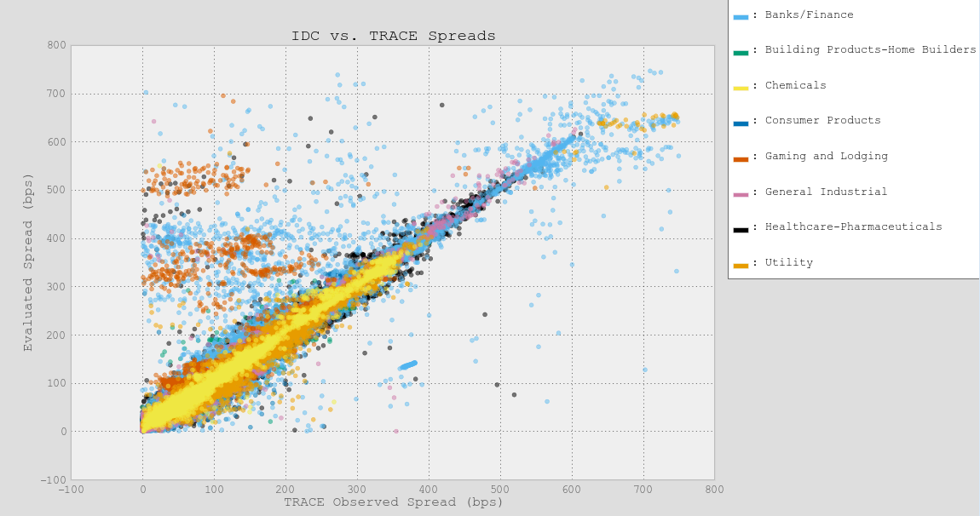
Bond Characteristics

Slide 9
Model Results
Model | Mean Squared Error | Basis Points Error
Benchmark (Eval) | 466.4 | 21.6 bps
Ridge Regression | 685.3 | 26.2 bps
Basic Decision Tree | 244.0 | 15.6 bps
Extra Tree Regressor | 232.6 | 15.3 bps
Random Forest Regressor | 160.0 | 12.6 bps

Slide 10
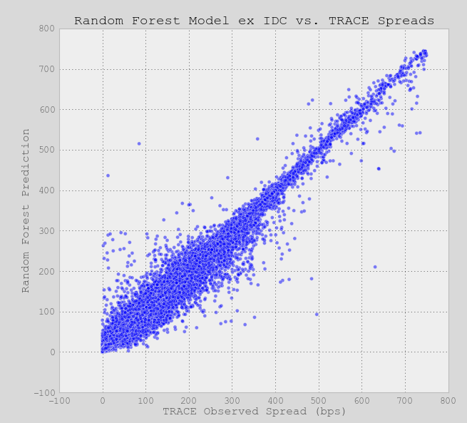
Random Forest Model Results

Slide 11
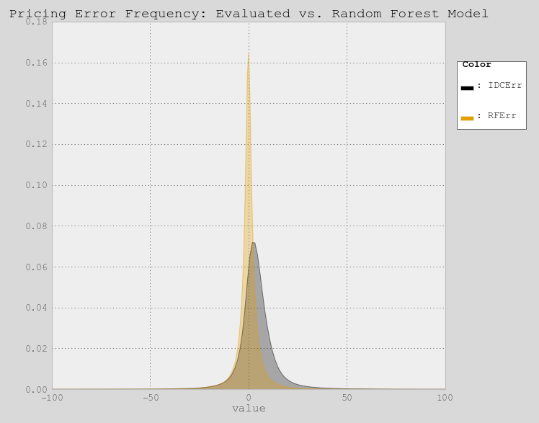
Error Frequency Analysis

